Slide 1

CS5187: Vision & Image
Zhu Zhiyu
Lecture 1: Images and image filtering
Hybrid Images, Oliva et al., http://olivalab.mit.edu/hybridimage.htm
Notes:
How about now?

Slide 2

What is an image?
Notes:
First, we should talk about what an image is.

Slide 3
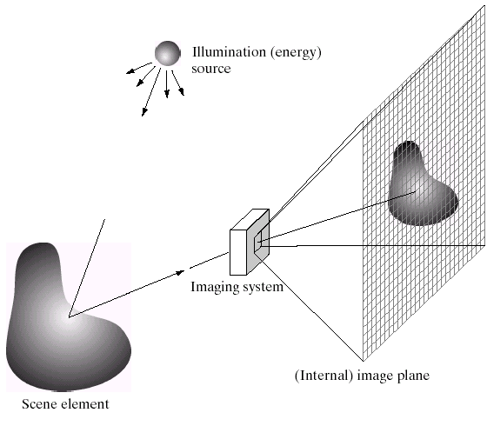
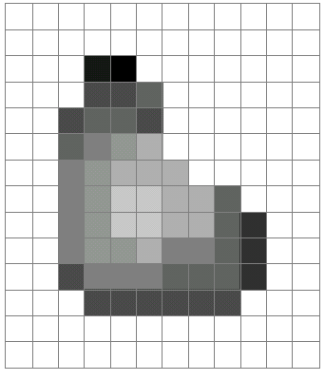
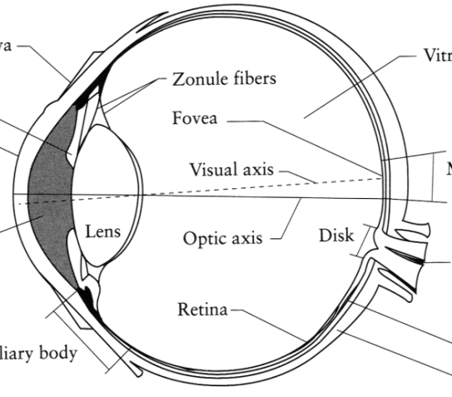
What is an image?
Digital Camera
We’ll focus on these in this class
(More on this process later)
The Eye
Source: A. Efros
Notes:
One way to think of an image is as a record of a set of light rays that bounce through space and hit a piece of light-sensitive film or a digital sensor.
Another way is to think of an image as just a grid of pixel values.
Another way is to think of an image as a response of our retinas to a light stimulus. In this class, we’ll focus on digital images. Later, we’ll come back to talk about how images are formed via the transmission of light through a scene.

Slide 4
What is an image?
A grid (matrix) of intensity values
(common to use one byte per value: 0 = black, 255 = white)
255 | 255 | 255 | 255 | 255 | 255 | 255 | 255 | 255 | 255 | 255 | 255
255 | 255 | 255 | 255 | 255 | 255 | 255 | 255 | 255 | 255 | 255 | 255
255 | 255 | 255 | 20 | 0 | 255 | 255 | 255 | 255 | 255 | 255 | 255
255 | 255 | 255 | 75 | 75 | 75 | 255 | 255 | 255 | 255 | 255 | 255
255 | 255 | 75 | 95 | 95 | 75 | 255 | 255 | 255 | 255 | 255 | 255
255 | 255 | 96 | 127 | 145 | 175 | 255 | 255 | 255 | 255 | 255 | 255
255 | 255 | 127 | 145 | 175 | 175 | 175 | 255 | 255 | 255 | 255 | 255
255 | 255 | 127 | 145 | 200 | 200 | 175 | 175 | 95 | 255 | 255 | 255
255 | 255 | 127 | 145 | 200 | 200 | 175 | 175 | 95 | 47 | 255 | 255
255 | 255 | 127 | 145 | 145 | 175 | 127 | 127 | 95 | 47 | 255 | 255
255 | 255 | 74 | 127 | 127 | 127 | 95 | 95 | 95 | 47 | 255 | 255
255 | 255 | 255 | 74 | 74 | 74 | 74 | 74 | 74 | 255 | 255 | 255
255 | 255 | 255 | 255 | 255 | 255 | 255 | 255 | 255 | 255 | 255 | 255
255 | 255 | 255 | 255 | 255 | 255 | 255 | 255 | 255 | 255 | 255 | 255
=

Slide 5
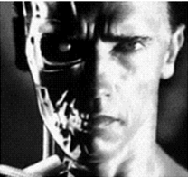
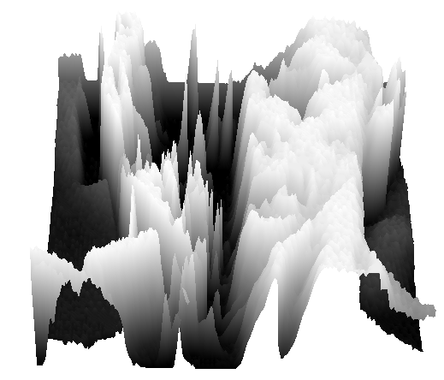
What is an image?
Can think of a (grayscale) image as a function f from R² to R:
  f (x,y) gives the intensity at position (x,y)
  A digital image is a discrete (sampled, quantized) version of this function
f (x, y)
x
y
snoop
3D view
Notes:
[Instructors note.] Here I show two demos.
One is “snoop” (https://www.csie.ntu.edu.tw/~cyy/projects/snoop/index.html), which is a Windows utility for zooming into the screen and showing the pixel values as numbers. So you can see brighter pixels have values close to 255, and darker pixels have values closer to 0. (Probably there exists some similar tool for Mac.)
The second demo is using Meshlab to open up a mesh that I’ve created to replicate an image, but where the “z” axis corresponds to intensity – really, just a visualization of the image as a function z = f(x,y). That mesh is here:
https://drive.google.com/open?id=1uJXcpQcWgRYlorrH_ctYn-yncEDvcxwV
If you look at it “head-on” it looks like the image of T100 above. If you move the viewpoint to the side, you see the image turn into hills and valleys. Bright regions are plateaus, dark regions are valleys, and “cliffs” represent edges in the image.

Slide 6
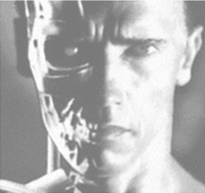
Image transformations
As with any function, we can apply operators to an image
Today we’ll talk about a special kind of operator, convolution (linear filtering)
  g (x,y) = f (x,y) + 20
  g (x,y) = f (-x,y)

Slide 7
Filters
Filtering
  Form a new image whose pixel values are a combination of the original pixel values
Why?
  To get useful information from images
    E.g., extract edges or contours (to understand shape)
  To enhance the image
    E.g., to remove noise
    E.g., to sharpen and “enhance image” a la CSI
  A key operator in Convolutional Neural Networks

Slide 8
Canonical Image Processing problems
Image Restoration
  denoising
  deblurring
Image Compression
  JPEG, HEIF, MPEG, …
Locating Structural Features
  corners
  edges

Slide 9
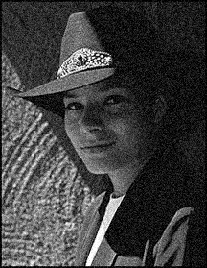
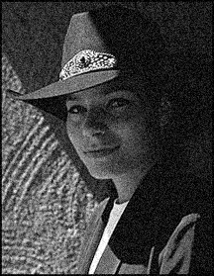

Question: Noise reduction
Given a camera and a still scene, how can you reduce noise?
Take lots of images and average them!
What’s the next best thing?
Source: S. Seitz
Notes:
Answer: take lots of images, average them

Slide 10
Image filtering
Modify the pixels in an image based on some function of a local neighborhood of each pixel
10
5
3
Some function
4
5
1
7
1
1
7
Local image data
Modified image data
Source: L. Zhang

Slide 11
Linear filtering
One simple version of filtering: linear filtering (cross-correlation, convolution)
  Replace each pixel by a linear combination (a weighted sum) of its neighbors
The prescription for the linear combination is called the “kernel” (or “mask”, “filter”)
10
5
3
0
0
0
4
6
1
0
0.5
0
8
1
1
8
0
1
0.5
Local image data
kernel
Modified image data
Source: L. Zhang

Slide 12



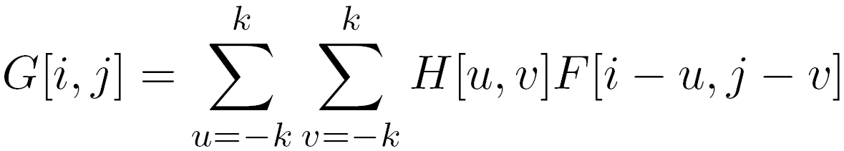

Convolution
Let be the image, be the kernel (of size 2k+1 x 2k+1), and be the output image
Can think of as a “dot product” between local neighborhood and kernel for each pixel
This is called a convolution operation:

Slide 13



Convolution
Adapted from F. Durand

Slide 14

Mean filtering
0 | 0 | 0 | 0 | 0 | 0 | 0 | 0 | 0 | 0
0 | 0 | 0 | 0 | 0 | 0 | 0 | 0 | 0 | 0
0 | 0 | 0 | 90 | 90 | 90 | 90 | 90 | 0 | 0
0 | 0 | 0 | 90 | 90 | 90 | 90 | 90 | 0 | 0
0 | 0 | 0 | 90 | 90 | 90 | 90 | 90 | 0 | 0
0 | 0 | 0 | 90 | 0 | 90 | 90 | 90 | 0 | 0
0 | 0 | 0 | 90 | 90 | 90 | 90 | 90 | 0 | 0
0 | 0 | 0 | 0 | 0 | 0 | 0 | 0 | 0 | 0
0 | 0 | 90 | 0 | 0 | 0 | 0 | 0 | 0 | 0
0 | 0 | 0 | 0 | 0 | 0 | 0 | 0 | 0 | 0
 | 0 | 10 | 20 | 30 | 30 | 30 | 20 | 10
 | 0 | 20 | 40 | 60 | 60 | 60 | 40 | 20
 | 0 | 30 | 60 | 90 | 90 | 90 | 60 | 30
 | 0 | 30 | 50 | 80 | 80 | 90 | 60 | 30
 | 0 | 30 | 50 | 80 | 80 | 90 | 60 | 30
 | 0 | 20 | 30 | 50 | 50 | 60 | 40 | 20
 | 10 | 20 | 30 | 30 | 30 | 30 | 20 | 10
 | 10 | 10 | 10 | 0 | 0 | 0 | 0 | 0
*
=
1 | 1 | 1
1 | 1 | 1
1 | 1 | 1

Slide 15
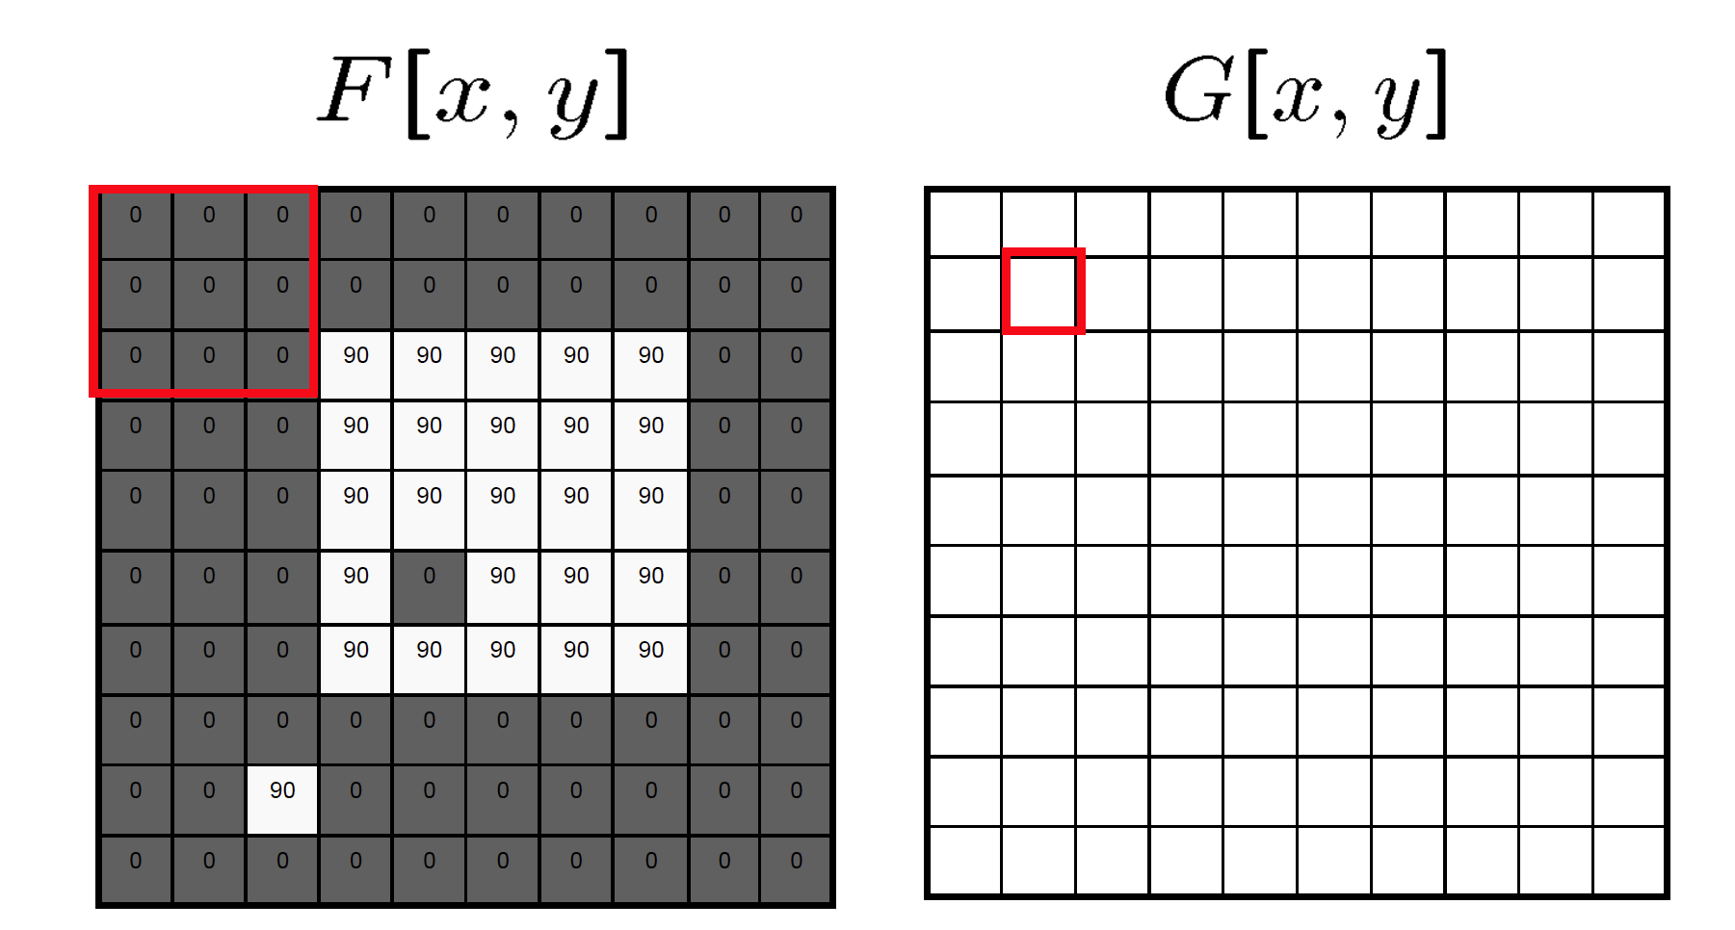
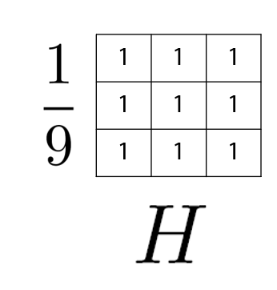
Mean filtering / Moving average

Slide 16
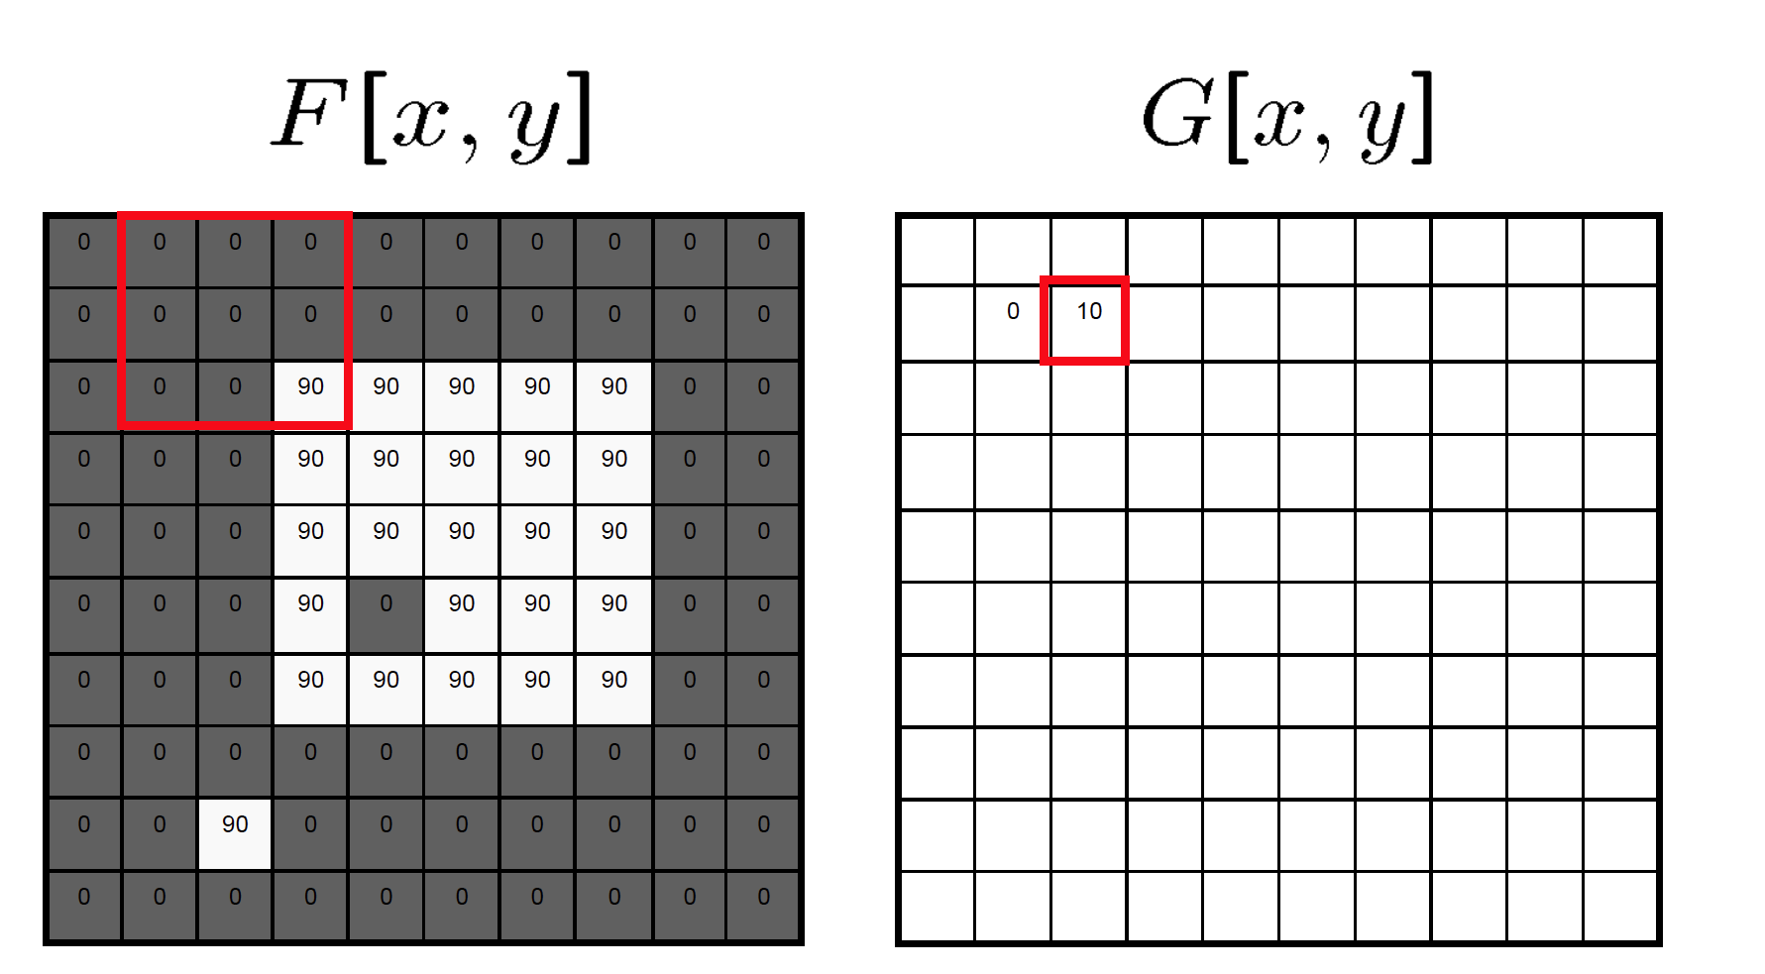
Mean filtering / Moving average

Slide 17

Mean filtering / Moving average

Slide 18
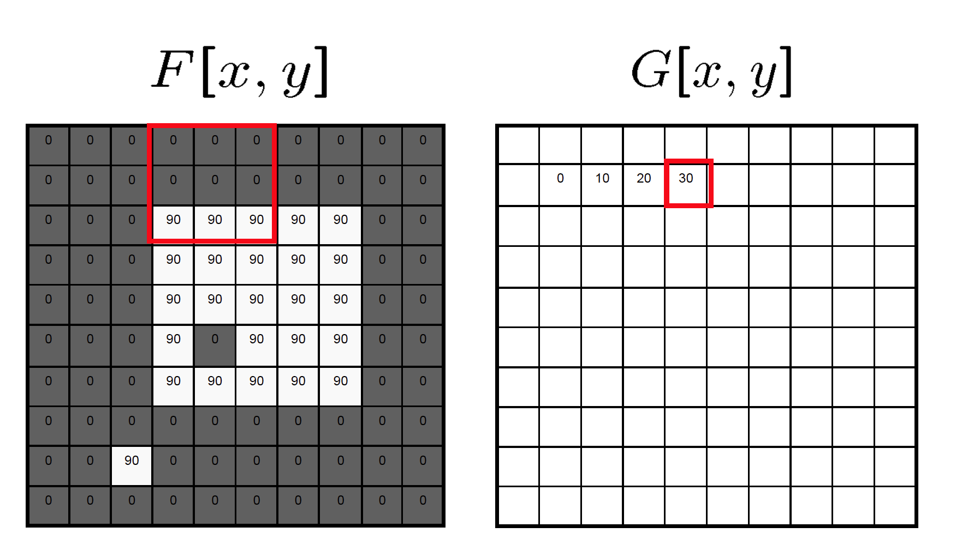
Mean filtering / Moving average

Slide 19
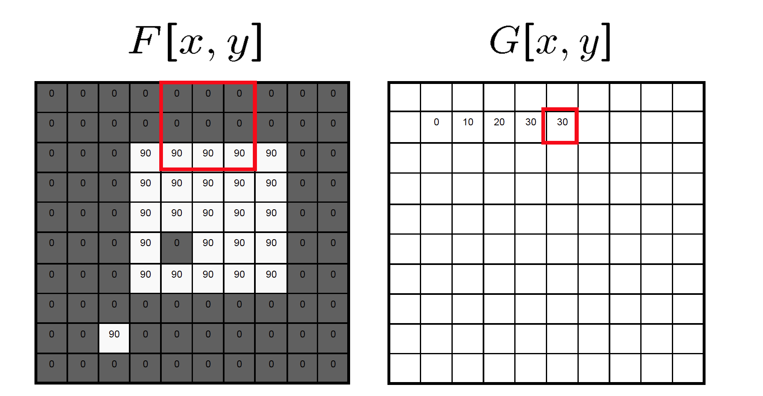
Mean filtering / Moving average

Slide 20
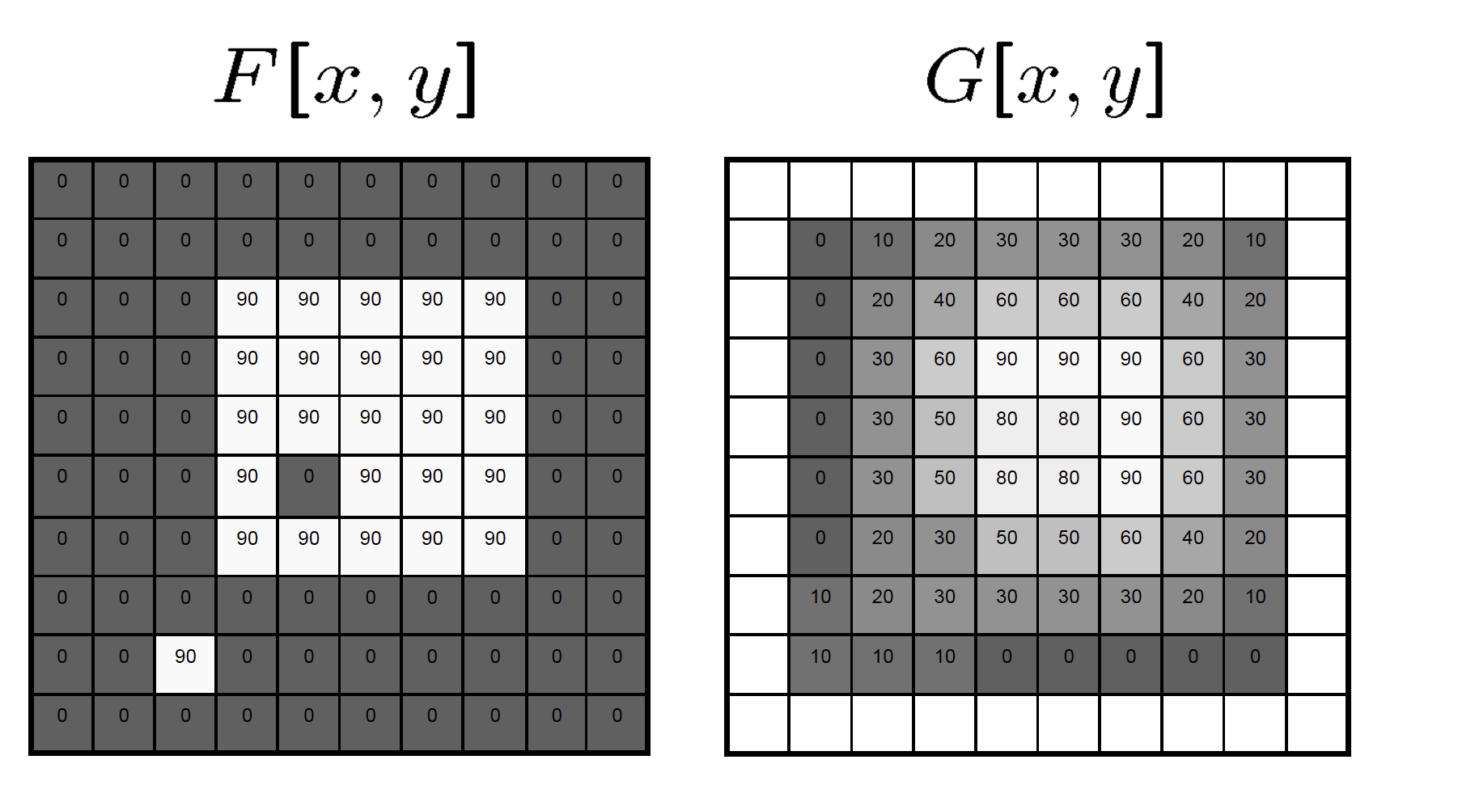
Mean filtering / Moving average

Slide 21
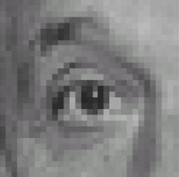
Linear filters: examples
*
0
0
0
0
1
0
0
0
0
Original
Source: D. Lowe

Slide 22
Linear filters: examples
*
0
0
0
=
0
1
0
0
0
0
Original
Identical image
Source: D. Lowe

Slide 23
Linear filters: examples
*
0
0
0
1
0
0
0
0
0
Original
Source: D. Lowe

Slide 24
Linear filters: examples
*
0
0
0
=
1
0
0
0
0
0
Original
Shifted left by 1 pixel
Source: D. Lowe

Slide 25
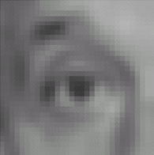

Linear filters: examples
*
1
1
1
=
1
1
1
1
1
1
Original
Blur (with a mean filter)
Source: D. Lowe

Slide 26
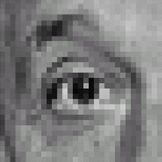



Linear filters: examples
*
0
0
0
-
1
1
1
=
0
2
0
1
1
1
0
0
0
1
1
1
Sharpening filter (accentuates edges)
Original
Source: D. Lowe

Slide 27
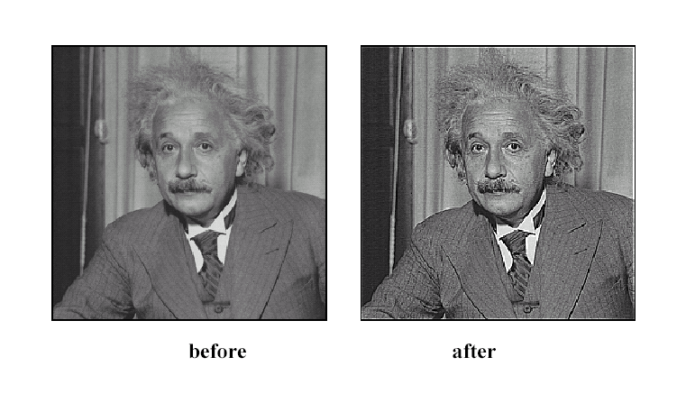
Sharpening
Source: D. Lowe

Slide 28
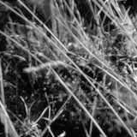
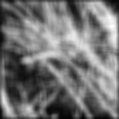
Smoothing with box filter revisited
Source: D. Forsyth
Notes:
I always walk through the argument on the left rather carefully; it gives some insight into the
significance of impulse responses or point spread functions.

Slide 29
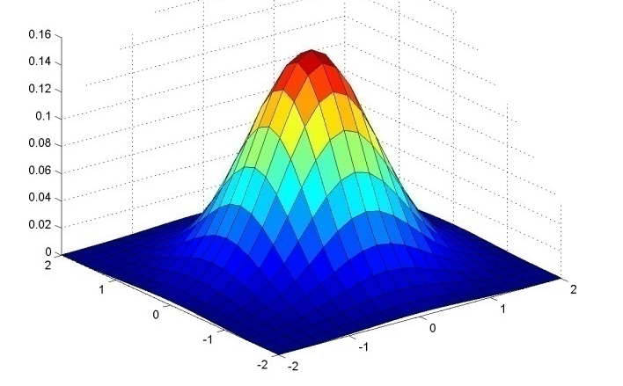
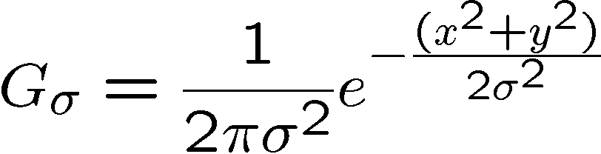
Gaussian kernel
Source: C. Rasmussen

Slide 30
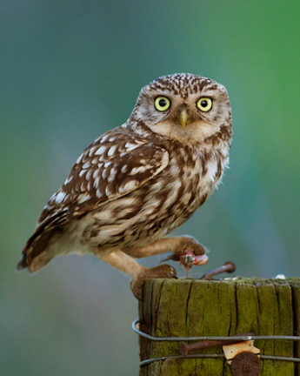
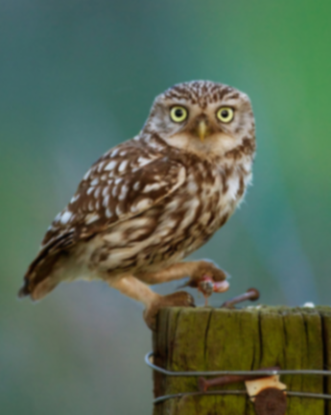








Gaussian filters
= 1 pixel
= 5 pixels
= 10 pixels
= 30 pixels

Slide 31
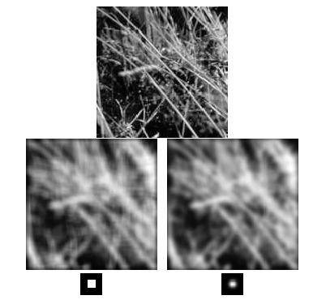
Mean vs. Gaussian filtering

Slide 32



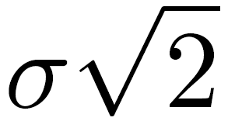
Gaussian filter
Removes “high-frequency” components from the image (low-pass filter)
Convolution with self is another Gaussian
  Convolving twice with Gaussian kernel of width = convolving once with kernel of width
*
=
Source: K. Grauman
Notes:
Linear vs. quadratic in mask size

Slide 33
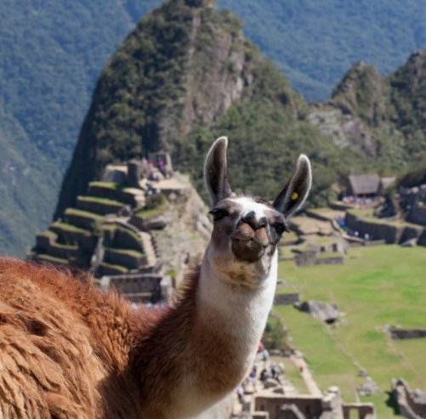

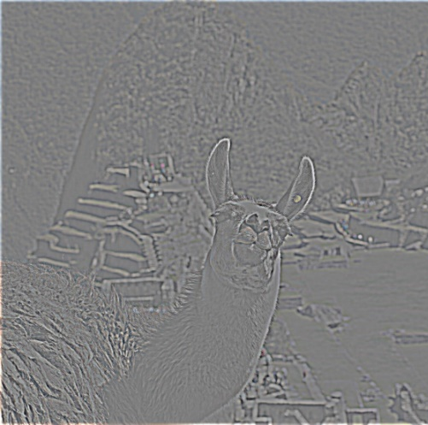
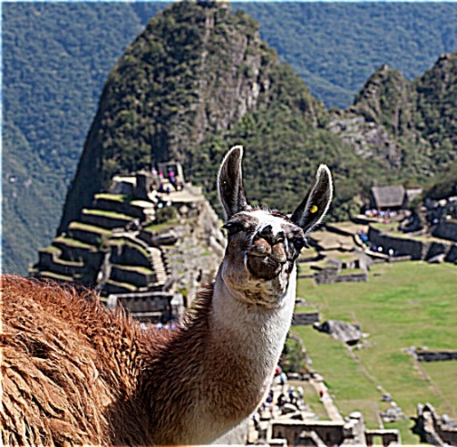
Sharpening revisited
What does blurring take away?
–
=
original
smoothed (5x5)
detail
(This “detail extraction” operation is also called a high-pass filter)
Let’s add it back:
+ α
=
original
detail
sharpened
Photo credit: https://www.flickr.com/photos/geezaweezer/16089096376/

Slide 34
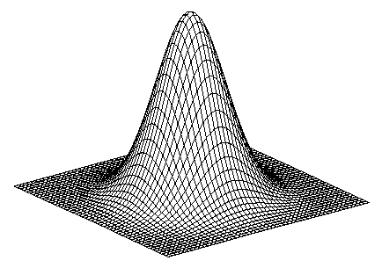
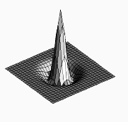

Sharpen filter
+
blurred
image
image
unit impulse
(identity kernel with single 1 in center, zeros elsewhere)
scaled impulse
Gaussian
Sharpen filter
Notes:
This slide derives a sharpen filter from the intuition in the previous slide – i.e., “sharpening is taking an image I, blurring it, subtracting the blurred image from I to get high-frequency edges, then scaling and adding those edges back to I to yield an image with emphasized edges).
f + a(f - f * g) = (1+a)f-af*g = f*((1+a)e-ag)

Slide 35

Sharpen filter
unfiltered
filtered
Notes:
Note how in sharpened region of the image (also known as “unsharp mask filtered” image), the edges are transformed so that the image gets darker on one side and brighter on the other – in this way, the edge is emphasized. The sharpened image “anticipates” the edges.

Slide 36
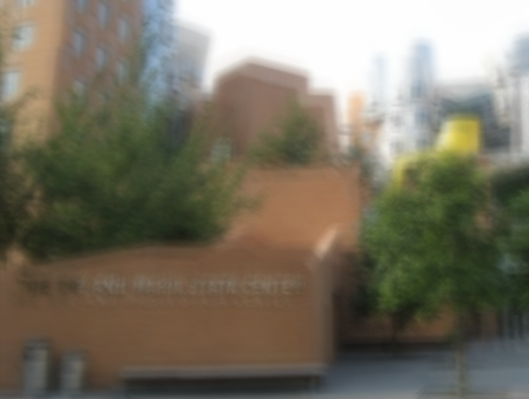
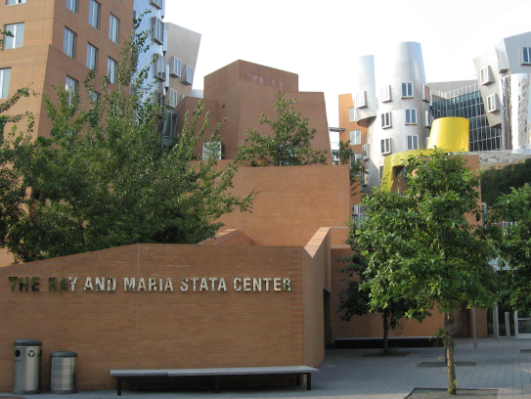
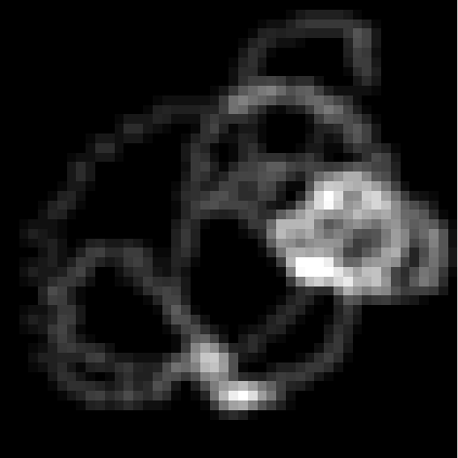
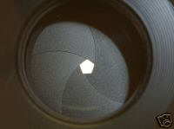


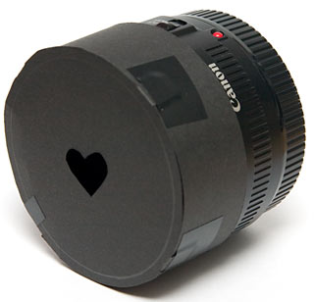
“Optical” convolution
Camera shake
=
*
Source: Fergus, et al. “Removing Camera Shake from a Single Photograph”, SIGGRAPH 2006
Bokeh: Blur in out-of-focus regions of an image.
Source: https://www.diyphotography.net/diy_create_your_own_bokeh/

Slide 37
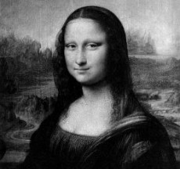
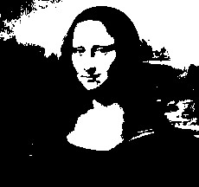

Filters: Thresholding

Slide 38
Linear filters
Can thresholding be implemented with a linear filter?
Notes:
Answer: No.

Slide 39
Questions?

